Slide 1
PRODML PVT
Worked Example Tutorial (v1)
For PRODML v2.0

Slide 2
Overview
This presentation deck includes slides for the PVT worked example. For more information, see the PRODML Technical Usage Guide, which is included in the zip file when you download PRODML from the Energistics website.

Slide 3
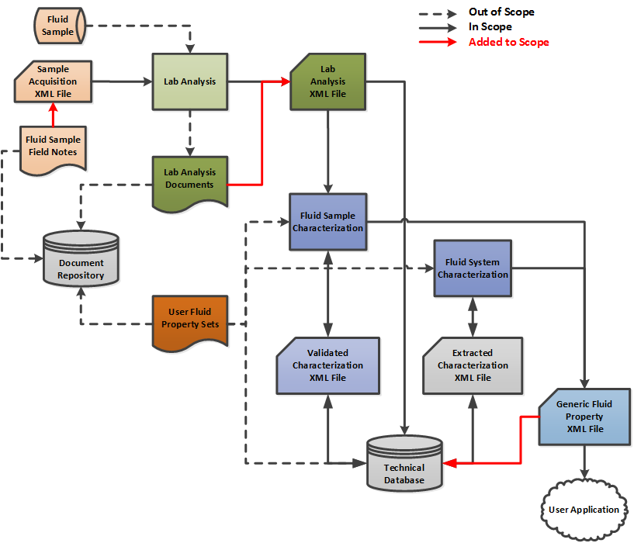
PVT Capability Scope

Slide 4
PVT Worked Example workflow

Slide 5
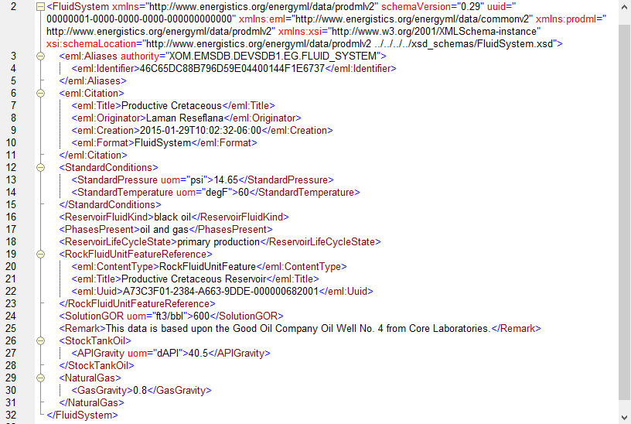
Fluid System describes the reservoir and fluid contained in it – high-level outline
Uuid is used by other objects to reference this one
Basic characterization of fluid system and of fluid properties
The rock fluid unit feature is a way to sub-divide the fluid system into, e.g. layers. It is also a reference to a RESQML object of the same name

Slide 6
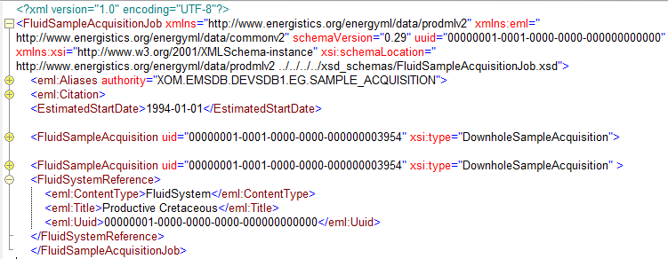
Fluid Sample Acquisition Job describes the operation of sample acquisition
Multiple sample acquisitions within the “job”
Reference to fluid system

Slide 7
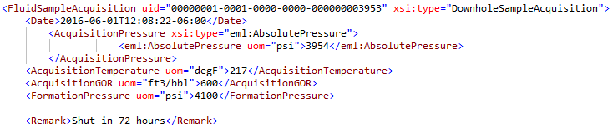
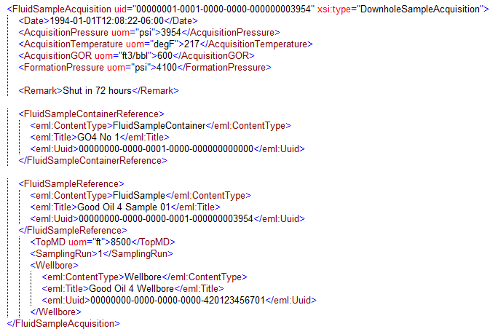
Fluid Sample Acquisition has the details of the operation to acquire each individual sample
Operational data – more details are available in schema
Reference to the fluid sample container used
Reference to the fluid sample acquired
Reference to the wellbore

Slide 8
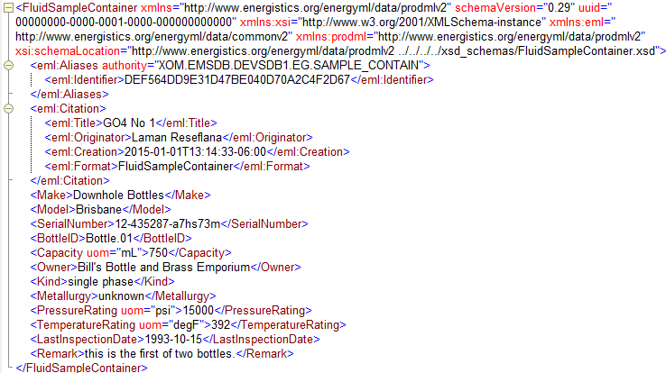
Fluid Sample Container example. It does not reference other objects; they reference it

Slide 9
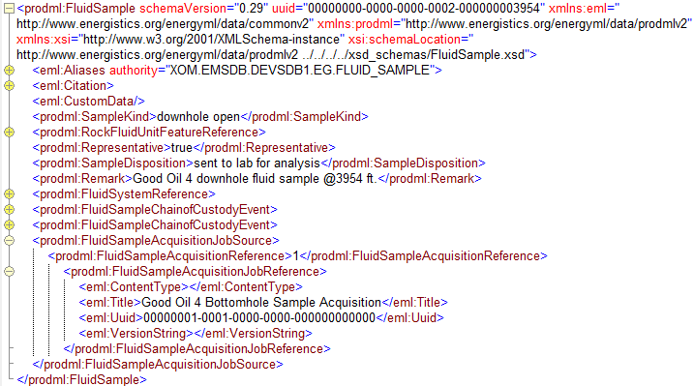
Fluid Sample showing references to its provenance
Fluid system and rock fluid unit feature – where sample was taken from
Fluid sample acquisition (operation), and the job within which this occurred

Slide 10
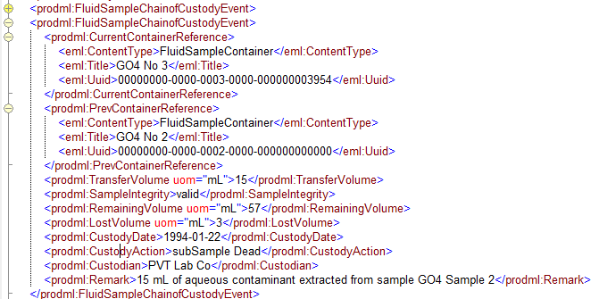
Fluid sample chain of custody event – showing a sub-sample of aqueous phase being taken
There may be multiple chain of custody events
These references to fluid sample containers are how the transfer of samples between containers is recorded
Chain of custody event has a Custody Action enumeration

Slide 11
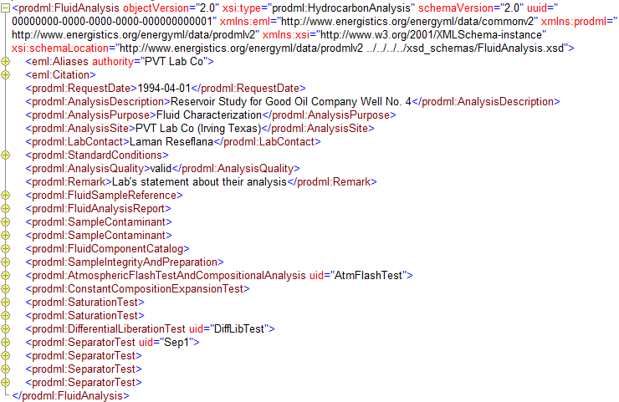
Fluid Analysis – Hydrocarbon, high-level contents
Reference to the fluid sample
Reference to an external report file
Details of sample contaminants
Fluid component catalog
Details of sample integrity and preparation
Details of analysis tests performed

Slide 12
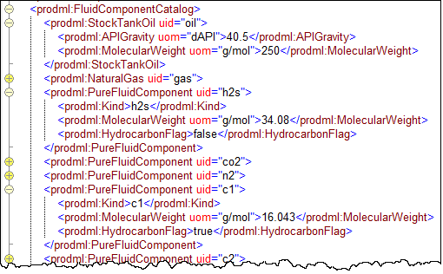
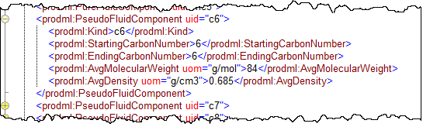
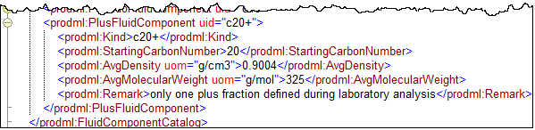
Fluid analysis – fluid component catalog showing various kinds
Black oil components
Inorganic components
Pure hydrocarbon components
Pseudo hydrocarbon components
Plus hydrocarbon components

Slide 13
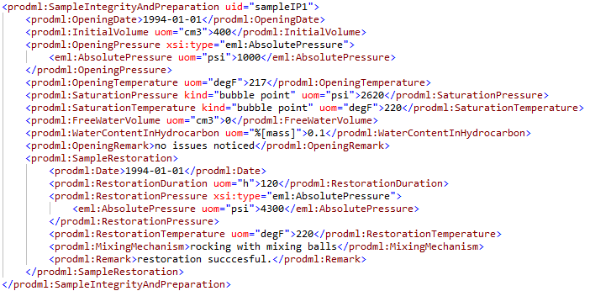
Fluid analysis – sample integrity and preparation

Slide 14
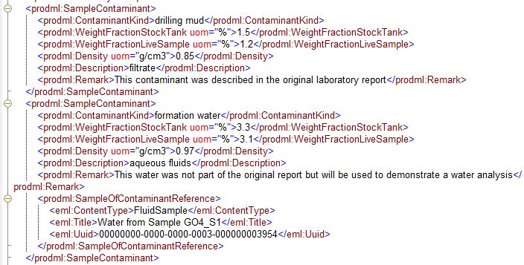
Fluid analysis – sample contaminant, showing reference to a sample of contaminant
Multiple sample contaminants can be included, showing % contamination
For this contaminant, a sample is available and is referenced here

Slide 15
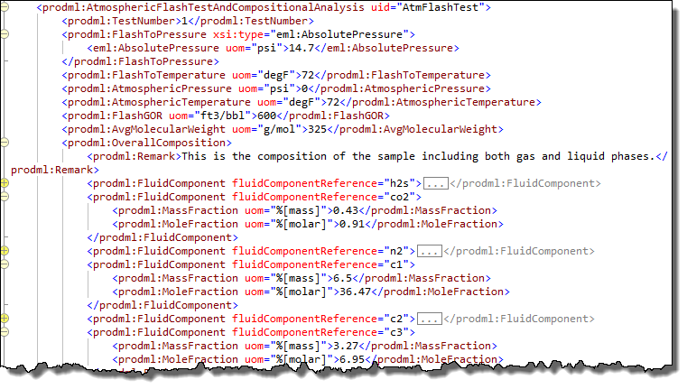
Fluid analysis – use of fluid components previously defined in fluid component catalog
Test uid can be used to reference this test from elsewhere
Test overall data
Compositions use the uid of the fluid components in the catalog to reference them, adding the fractions for this instance

Slide 16
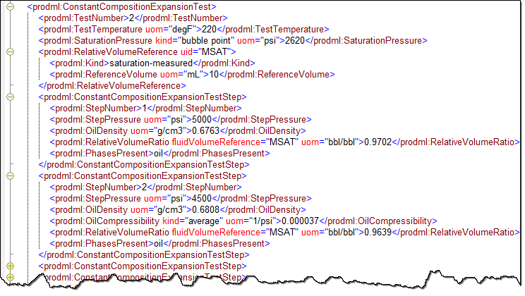
Fluid analysis – many tests have a pattern of common data followed by recurring test steps

Slide 17
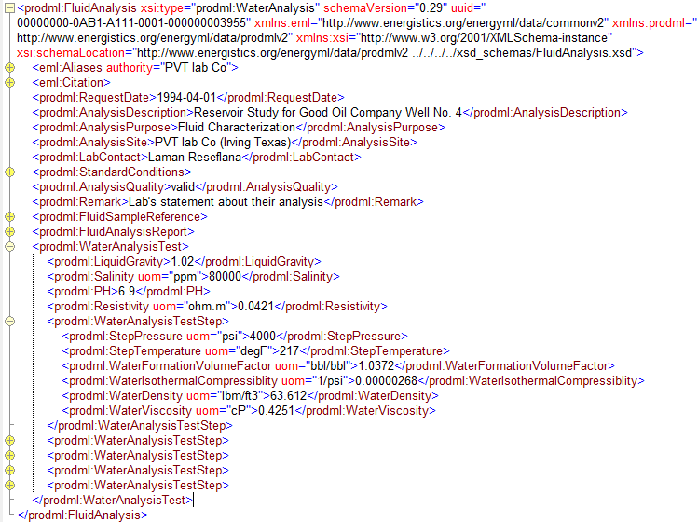
Fluid analysis – water analysis test
Fluid analysis object type is water analysis
There is just one type of water analysis test
Multiple test steps can be reported

Slide 18
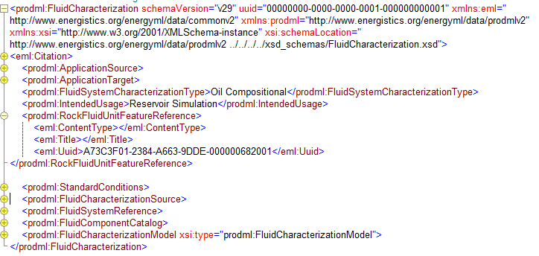
Fluid Characterization – model, high-level contents
Software used to generate and target for consumption
References to other objects
Fluid component catalog
Fluid characterization model

Slide 19

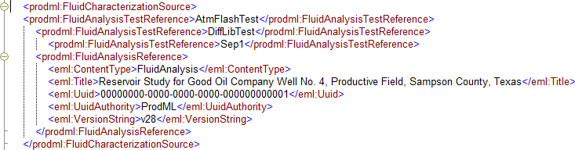
Fluid charaterization – software applications and fluid analysis data sources
Software used to generate and target for consumption
Fluid characterization source
Fluid analysis tests used in this characterization
Reference to the fluid analysis object containing these tests

Slide 20
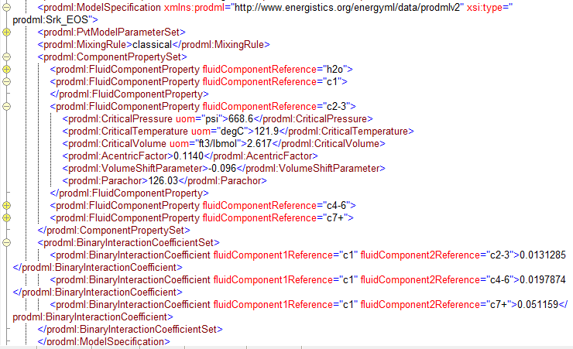
Fluid characterization – model specification
Model type
Properties which apply to the whole model
Properties which apply to each fluid component
Binary Interaction coefficients

Slide 21
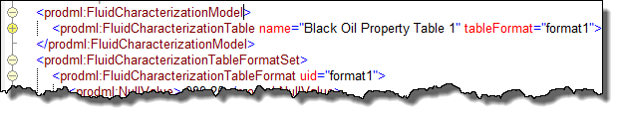
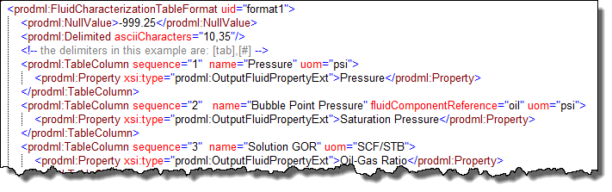
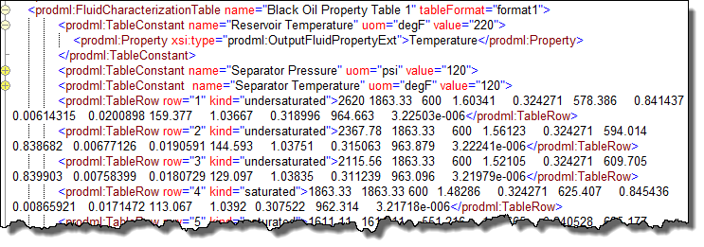
Fluid characterization – tabular specification
Table and Table Format
Format for a table is contained in one element and referenced from the table
Table format
Table

